Slide 1

SANTHIRAM ENGINEERING COLLEGE
(AUTONOMOUS)
INTELLIGENT INDOOR AIR QUALITY (IAQ) MONITORING AND FORECASTING SYSTEM
By:-Batch No:7
Under the guidance of T. Vijaya Mary (22X51A05E7)
S.Nazia Banu ,M.sc,M.Tech. U. Hemalatha (22X51A05E9)
Assistant Professor P. Swathi (22X51A05G2)
K. Suvarsha (23X51A0505)
V. Malleswari(22X51A05F2)

Slide 2
INDEX
ABSTRACT
OBJECTIVE
INTRODUCTION
EXISTING SYSTEM
DISADVANTAGES
PROPOSED SYSTEM
ARCHITECTURE
HARDWARE AND SOFTWARE REQUIREMENTS
MODULES
ADVANTAGES
TESTING
CONCLUSION
FUTURE SCOPE

Slide 3
abstract
Indoor Air Quality (IAQ) has emerged as a crucial determinant of health and cognitive performance, especially in enclosed public spaces like hospitals and academic institutions. This project presents an intelligent IAQ monitoring and forecasting system that combines IoT-based environmental sensing, complex event processing (CEP), and advanced machine learning techniques. The system captures real-time measurements of pollutants such as carbon dioxide (CO₂), particulate matter (PM2.5), and total volatile organic compounds (TVOCs), along with temperature and humidity, using custom-built IoT sensor units installed across university lecture rooms.
.

Slide 4
OBJECTIVE
Real-time indoor air quality monitoring using IoT sensors to measure temperature, humidity, CO2, PM2.5,and
TVOCs.
Continuous and accurate data collection through custom-built sensor devices in enclosed environments.
Application of regression techniques to predict Air Quality Level (AQL) as a continuous value.
Use of classification models to categorize air quality into levels such as Good, Moderate, or Unhealthy.
Implementation of advanced models like LSTM, Decision Trees, and Random Forests for forecasting and
improved accuracy.
Generation of real-time alerts and automated control of ventilation systems to maintain sefe and healthy indoor
conditions.

Slide 5
INTRODUCTION
IAQ monitoring system uses IoT sensors to collect pollutants (CO2,PM2.5,TVOCs) and environmental data in real time.
Machine learning models like LSTM are used for time-series forecasting of air quality levels.
Decision Tree classifiers provide interpretable categorization of air quality conditions.
Random Forest models enable accurate numerical prediction of air quality metrics.
Complex Event Processing (CEP) detects anomalies and sudden pollution spikes from streaming data.
The integrated system supports real-time insights and smart decision–making for healthier indoor environments.

Slide 6
These systems operate in a reactive manner, responding only after pollution levels exceed
safe limits instead of preventing issues in advance.
They do not support predictive analysis, as they lack AI or machine learning models to forecast
future air quality conditions.
The alert mechanisms are basic, relying only on fixed threshold values without providing
intelligent or real-time insights.
They lack automated anomaly detection, so unusual patterns in air quality data often go unnoticed.
They do not classify air quality into meaningful categories such as good, moderate, or poor, making
decision-making difficult.
They cannot dynamically optimize indoor environments, as they do not adjust ventilation or improve
air quality based on real-time data.
EXISTING SYSYTEM

Slide 7
DISADVANTAGES
Reactivity
Uninterpretability
Nonadaptability
Inefficiency
Inflexibility

Slide 8
PROPOSED SYSYTEM
The proposed IAQ monitoring framework introduces an intelligent, AI-driven approach by integrating IoT-based sensor networks, complex event processing (CEP), and machine learning models. Sensor data from CO₂, PM2.5, TVOCs, temperature, and humidity is analyzed using LSTM networks for time-series AQL regression. Simultaneously, Decision Tree Classifier is employed to categorize AQL into interpretable levels. Random Forest provides highly accurate predictions for continuous AQL values. The CEP engine facilitates real-time event detection and abnormal pattern identification. The proposed system not only enhances prediction accuracy and interpretability but also supports proactive decision-making and automated response for maintaining healthy indoor environments.

Slide 9
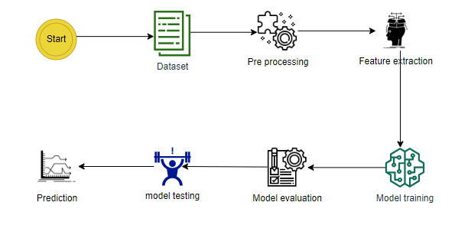
ARCHITECTURE

Slide 10
SOFTWARE REQUIREMENTS & HARDWARE REQUIREMENTS
SOFTWARE REQUIREMENS
Operating System : Windows 7/8/10
Server side Script : HTML, CSS, Bootstrap & JS
Programming Language : Python Libraries ,Flask, Pandas, Torch, Keras, Sklearn, Numpy , Seaborn
IDE/Workbench : VSCode
Server Deployment : Xampp Server
Database : MySQL
HARDWARE REQUIREMENTS
Processor - I3/Intel Processor
RAM - 8GB (min)
Hard Disk - 128 GB
Key Board - Standard Windows Keyboard
Mouse - Two or Three Button Mouse
Monitor - Any

Slide 11
MODULES
System:
Data Collection
Data Splitting
Model Training
Model Testing
Model Prediction

Slide 12
User:
Register
Login
Upload Data(Admin/Research Mode)
Viewing Results
Logout

Slide 13
ADVANTAGES
Real-Time Monitoring and Event Detection
Accurate and Robust Predictions
Enhanced Interpretability
Automation and Smart Control
Scalable and Modular Design

Slide 14
TESTING
Unit Testing
Functional Testing
BlackBox Testing

Slide 15
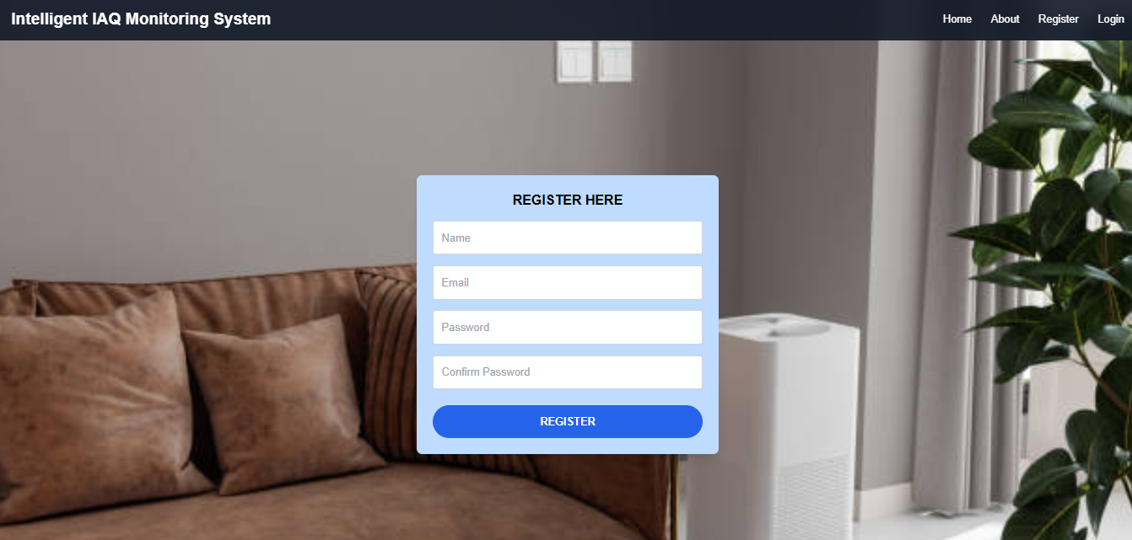
Results:
Fig: Registration Page

Slide 16
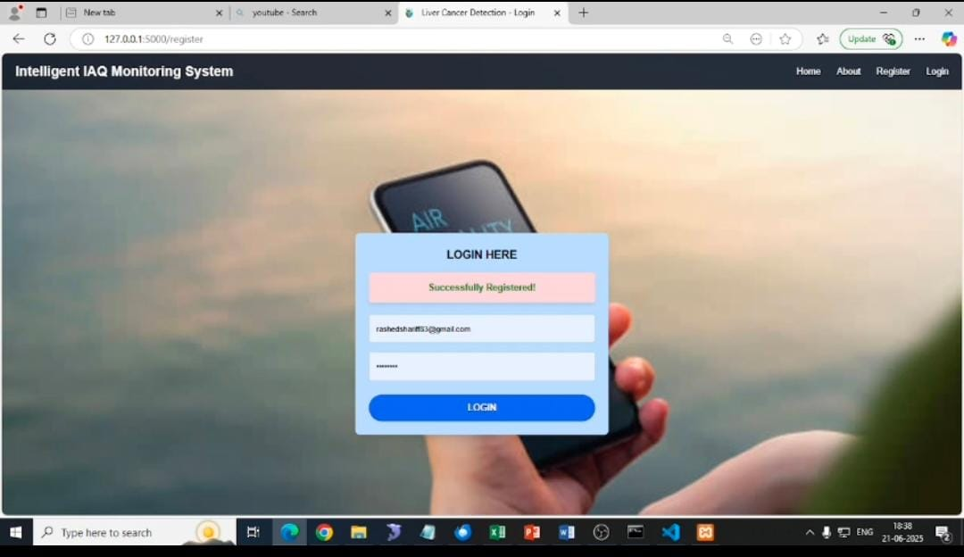
Fig:Login page

Slide 17
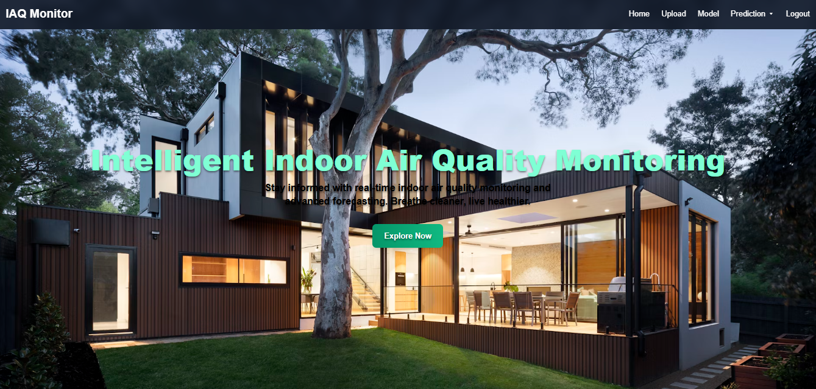
Fig:Home Page

Slide 18
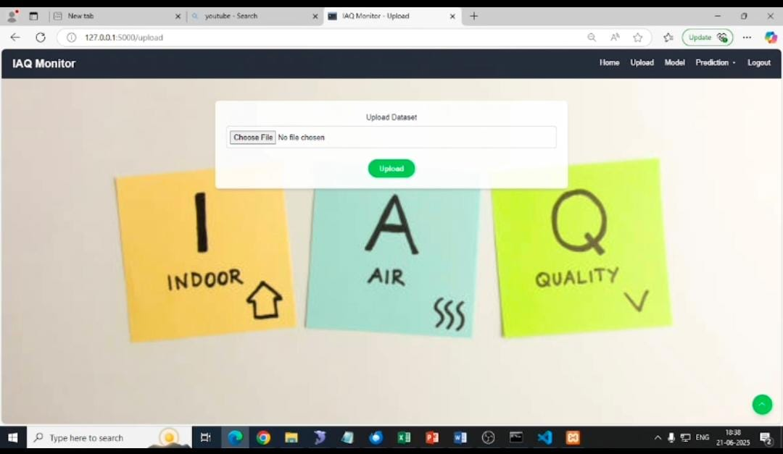
Fig: Uploading Dataset

Slide 19
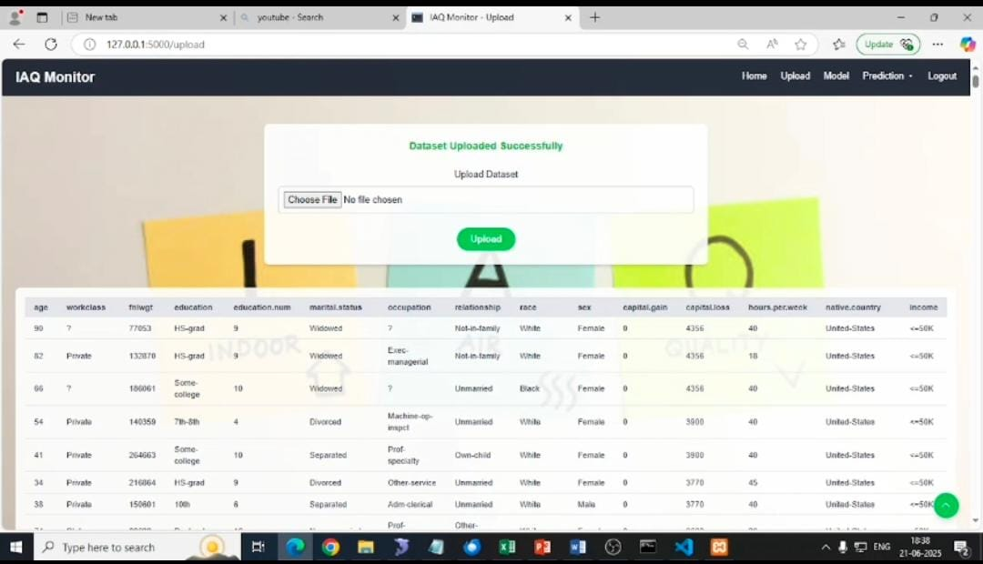
Fig: Uploaded Dataset Successfully

Slide 20
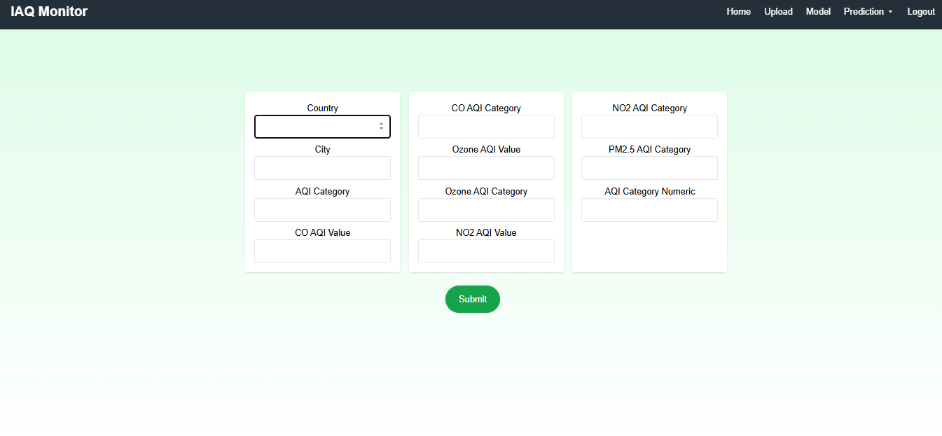
Fig:Prediction Page

Slide 21
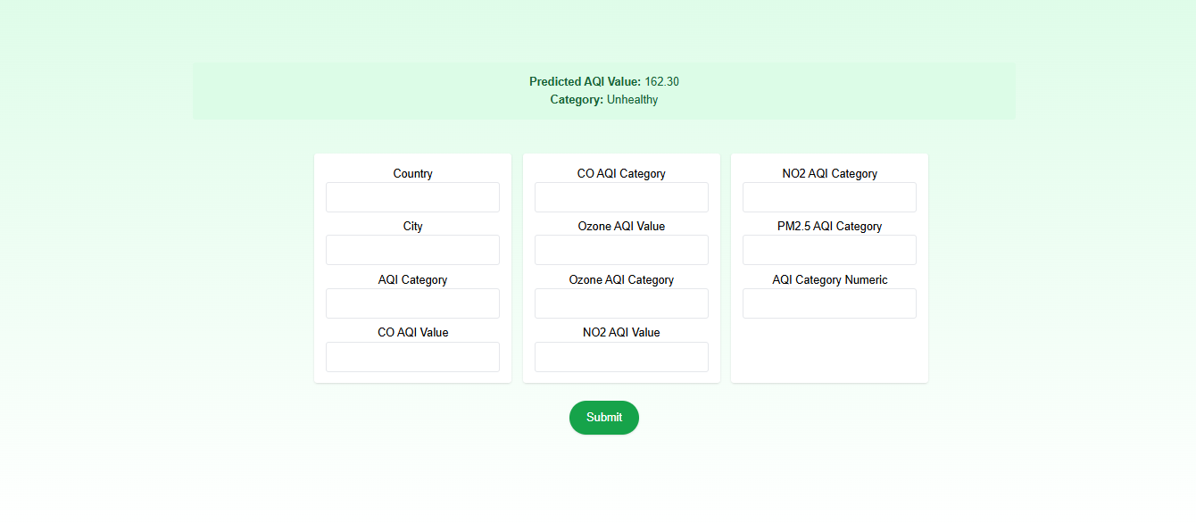
Fig: Result Page

Slide 22
CONCLUSION
The project integrates IoT, Machine Learning, and Complex Event Processing to create an intelligent system for real-time monitoring and forecasting of indoor air quality. It processes environmental data to enable both accurate prediction and classification of air quality levels. LSTM models are used for time-series forecasting, while Decision Trees provide interpretable health risk categorization. Random Forest enhances prediction accuracy, and CEP enables anomaly detection with real-time alerts. Overall, the system supports proactive decision-making and offers a scalable solution for smart buildings and smart city environments.

Slide 23
FUTURE SCOPE
The system can be enhanced by integrating additional sensors such as NO₂, O₃, and CO to achieve more comprehensive pollutant monitoring. Deep reinforcement learning can further improve the system by enabling dynamic optimization of ventilation and filtration processes. Expanding deployment across various environments like hospitals, offices, and residential buildings can strengthen its adaptability and robustness. The inclusion of mobile applications and dashboards would allow real-time monitoring, alerts, and better user control. Additionally, integrating with HVAC systems and cloud platforms can support scalable, intelligent, and data-driven building management.

Slide 24
Thank you

